Slide 1


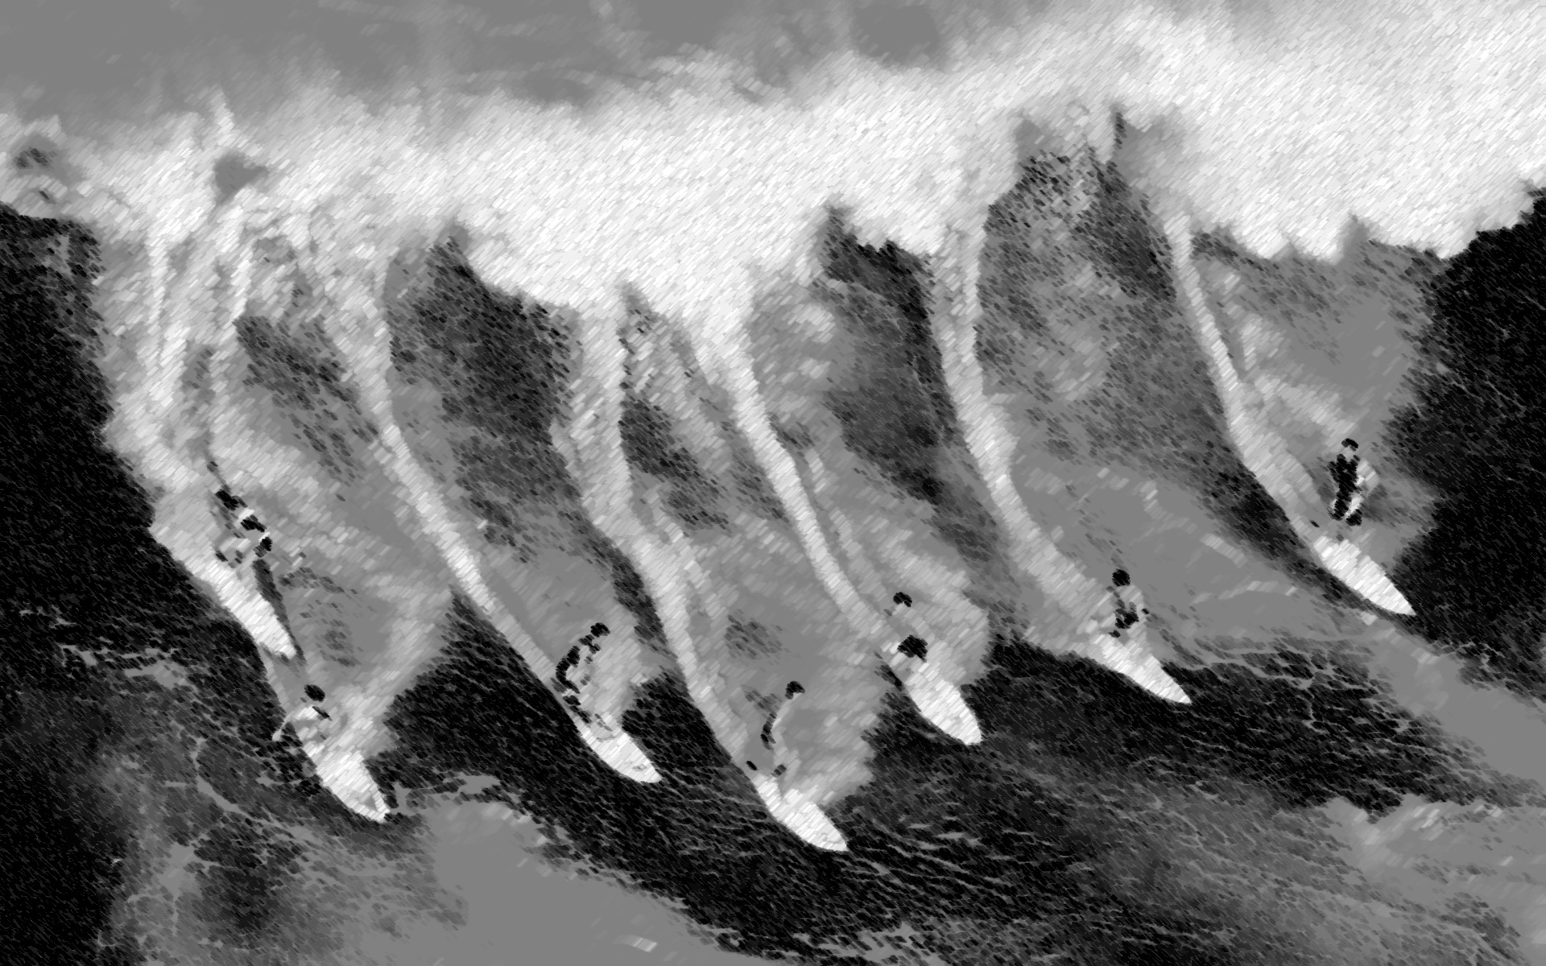

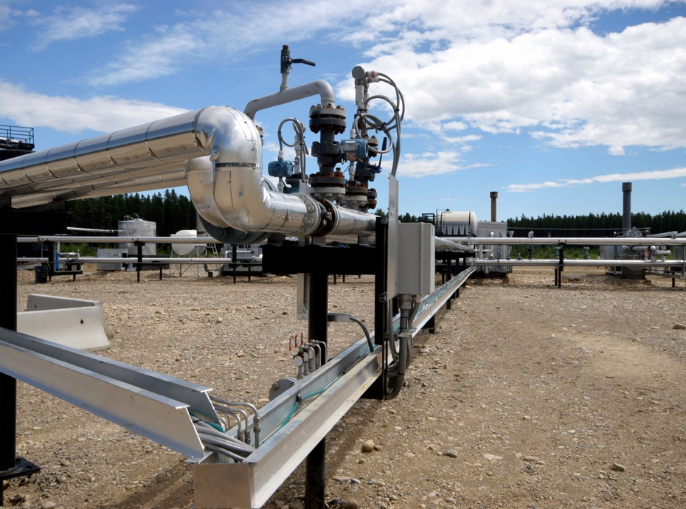
Sgouris Sgouridis
Denes Csala
MASDAR INSTITUTE
Renewable Energy Investment Ratio: Key to the
Global Sustainable Energy Transition
International Energy Workshop
Breakout Session
June 4
Abu Dhabi, 2015
Notes:
Managing the ride on the other side of the fossil wave is an act of balance

Slide 2
A-Ω
Defining Sustainable Energy Transitions (SET)
Guiding Principles for SET
Energy-balance model for RE-driven global SET
SET paths and landscapes
Implications for policy

Slide 3

Defining SET
A controlled process that leads
an advanced, technical society to
replace all major fossil fuel primary energy inputs with sustainably renewable resources
while maintaining a sufficient net energy service level per capita
Notes:
Mad max

Slide 4
4 SET Guidelines
The impacts of energy generation during SET do not exceed the long-run ecosystem carrying and assimilation capacity.
Per capita net available energy remains above the minimum level required to satisfy societal needs at any point during SET and without disruptive discontinuities in its rate of change.
The investment rate for the installation of renewable generation and consumption capital stock is sufficient to create a sustainable energy supply basis before the non-renewable safely recoverable resources are exhausted.
Financial commitments of future consumption (debt) should be limited by future energy availability.
environment
equity
economy
Notes:
Based on the original work by

Slide 5
An Energy Economy Mental Model: A Bridge for the Transition
Embodied
Energy
EROEI
Regulations, Norms and Institutions
→ Design objective: describe the economic dynamics purely on energy terms
Notes:
A framework/ language for SET based on energy

Slide 6
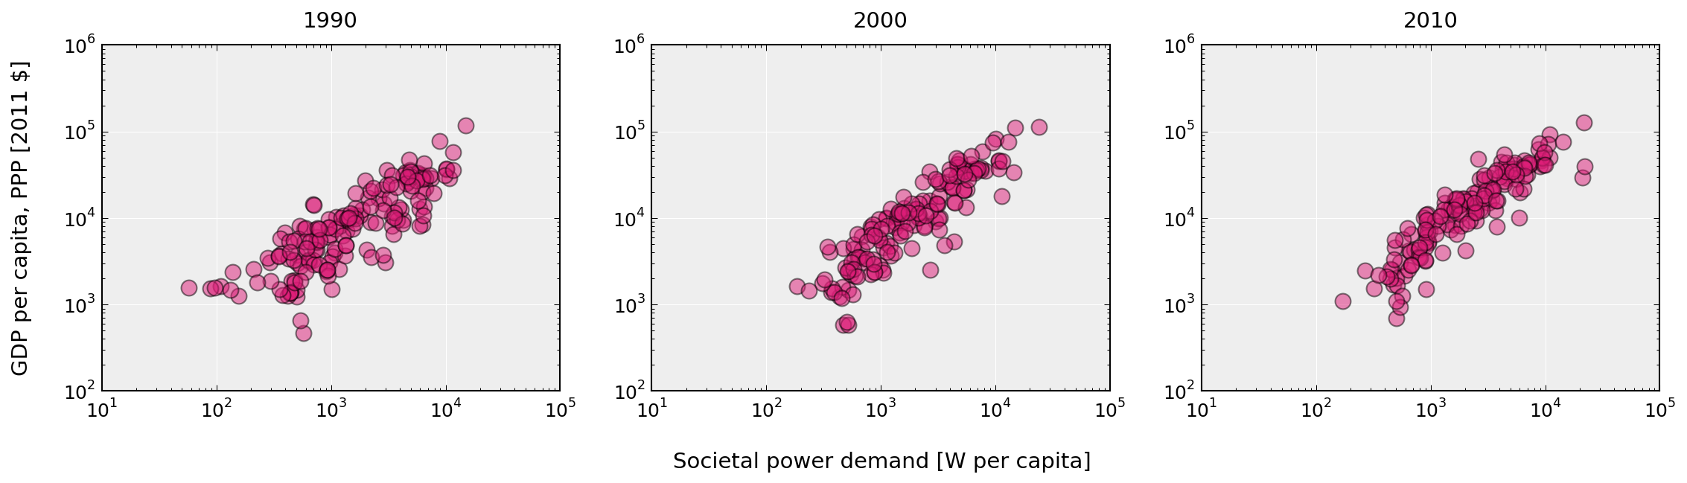
Energy and Economic Activity Strongly Correlated
How much power will we need?
Efficiencies of an electrification transition compensated:
Storage requirements
Overcapacity to overcome variability
Transformation to high energy density carriers
Figure: Sgouridis et al. (2015F)
Notes:
Ref talk in the morning – 20 trillion watts

Slide 7
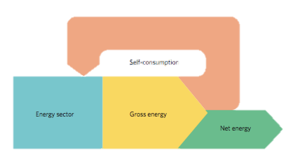
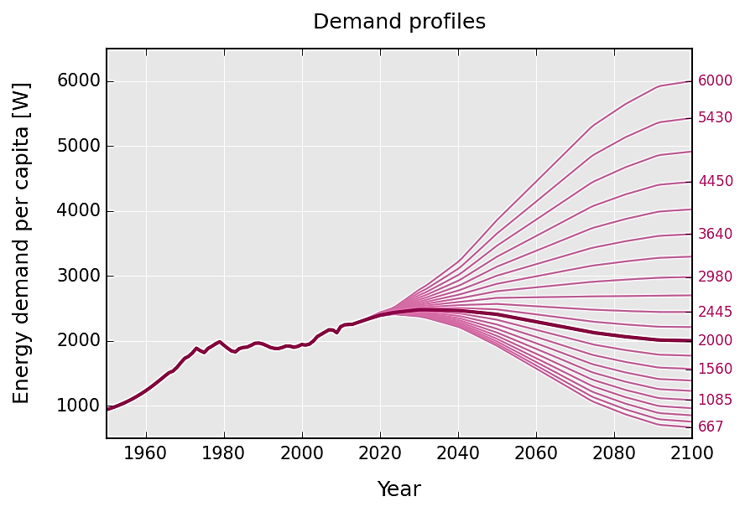
Net Energy is a decisive transition metric
Dale et al. (2014)
Pickard (2014)
Trainer (2014)
Spreng (2005)
RCP2.6
Marechal et al. (2005)
Jacobson , Delucchi (2011)
Figure: Sgouridis et al. (2015F)

Slide 8
Future Energy Supply
Power invested in RE
Fossil power
Renewable energy power
i: oil, gas, coal
j: hydro, nuclear, biomass, PV, CSP, wind, geo
For fossil fuels L≈ L_{in}

Slide 9
Energy Return on Energy Invested = EROEI
Solar PV 2.5? / 5 – 15
Wind 20 – 40
Solar CSP 10 – 20
Geothermal 15 – 35
Oil 25 – 10 [60 – 40]
Gas 25 – 15 [60 – 40]
Coal 50 – 15 [100 – 80]
Prieto and Hall (2014), Barnhart, Dale et al. (2013), Klemes (2015), Hall (2014)
King, Hall (2011), Gupta (2011), Moerschbaecher (2011), Kubiszewski (2010)
Figure: Own work based on Dale, Krumdieck (2012)
Notes:
Wealthy countries could afford to do that because of fossil fuels. 2 problems with that. Depletion and global warming.

Slide 10
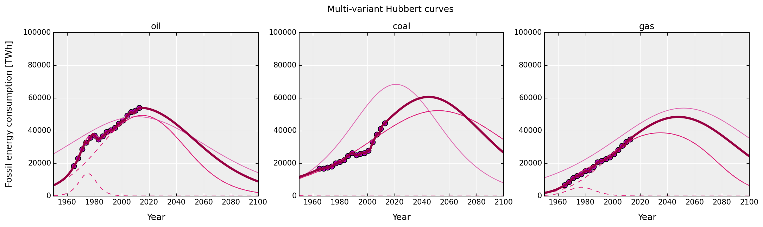
Whither Fossils?
Using a composite Hubbert curve for each resource (Maggio and Cacciola (2009, 2012) and reserve estimates Mohr (2015)
Figure: Own work based on Dale, et. al (2014)

Slide 11
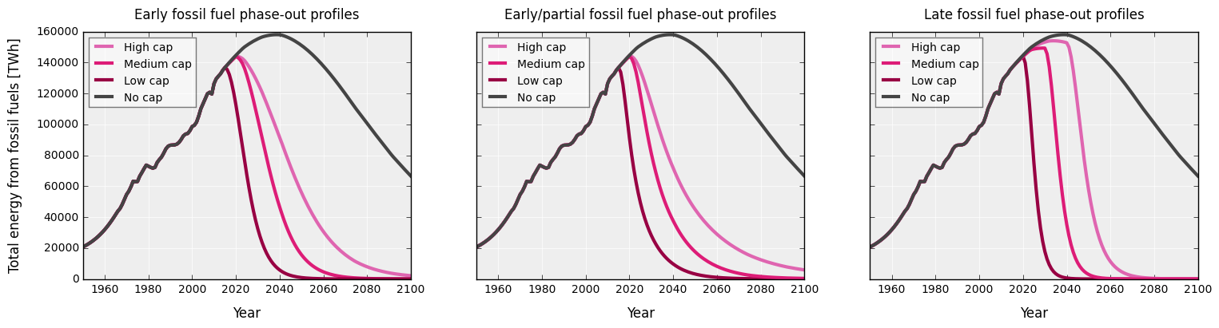
Whither Fossils? Caps and Phase-out Profiles
IPCC AR5 RCP2.6: 510, 990, 1505 GtCO2 range for 66% change less than 2C preindustrial:
3 phase-out profiles estimated as half Hubbert curve with the “safely recoverable reserves”

Slide 12
Workhorses of the SET
CCS wastes to much and location dependent
Biomass cannot be expected to expand much more (food system climate-change, water conflicts)
Nuclear is unlikely due to safety and scaling costs
Hydro perhaps doubling but not more resource
Geothermal power limited by location and cost (for thermal use)
At a global scale, it is PV, CSP and Wind that will need to step-in and scale-up to fill the gap

Slide 13
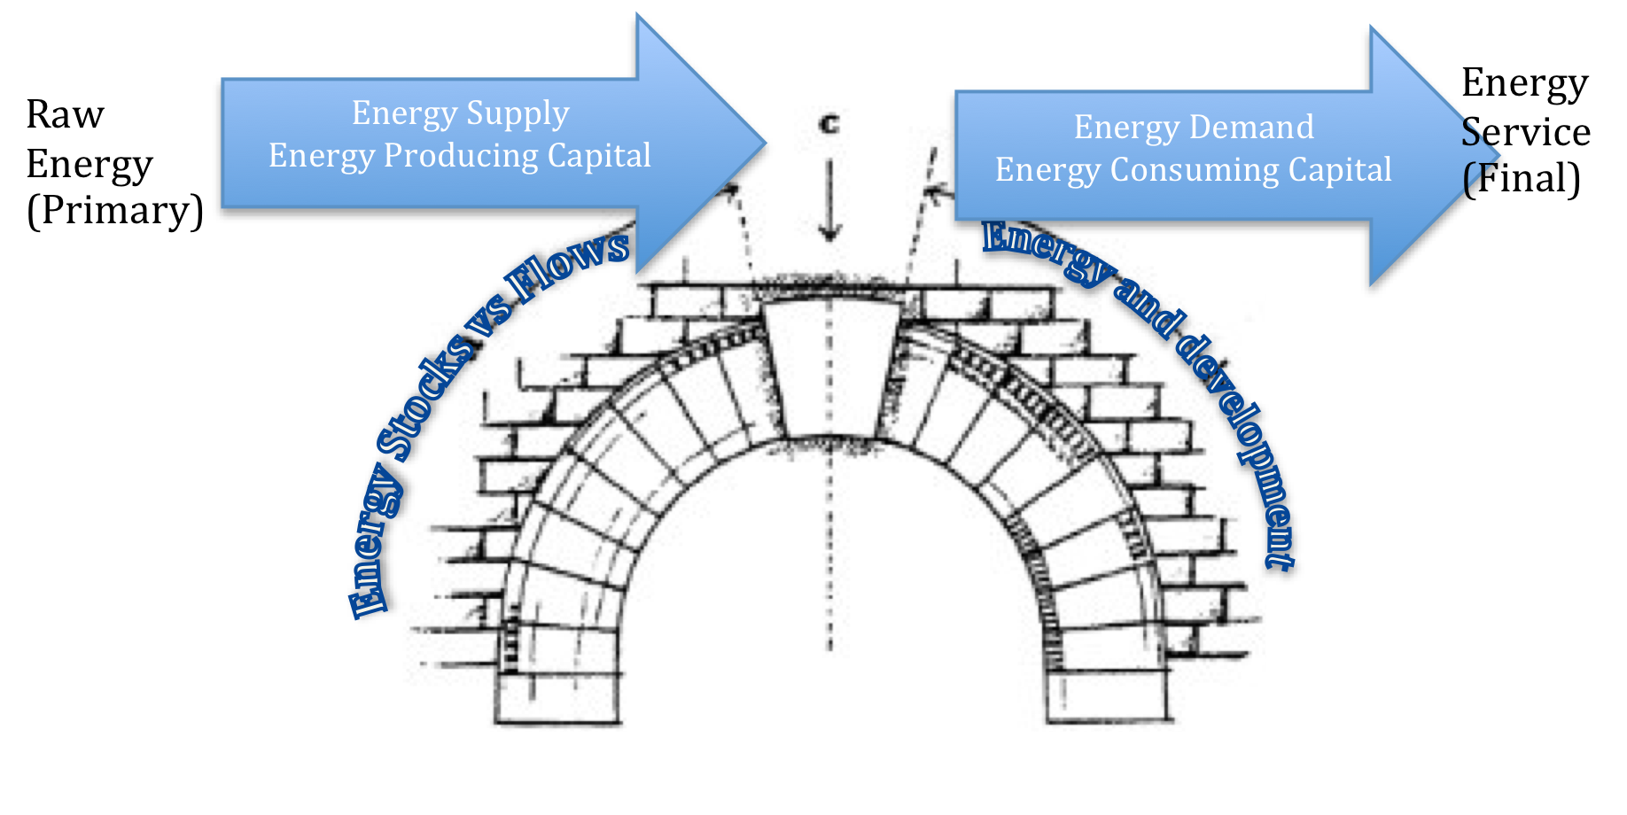
An Energy-balance Model: In a nutshell
Model the global energy supply dynamics with a single equation with parameters:
SRR: Safely recoverable fossil fuel reserves
R_{f}: EROEI of fossil fuels
ε: the ratio of available energy invested in building out RE
R_{r}: EROEI of RE
γ: Learning curve of RE
L: Lifetime of RE
→ Design objective: describe the economic dynamics on energy terms
Notes:
A framework/ language for SET based on energy

Slide 14
An Energy-balance Model: In a nutshell
Where are the economics ???
→ Design objective: describe the economic dynamics on energy terms
Notes:
A framework/ language for SET based on energy

Slide 15
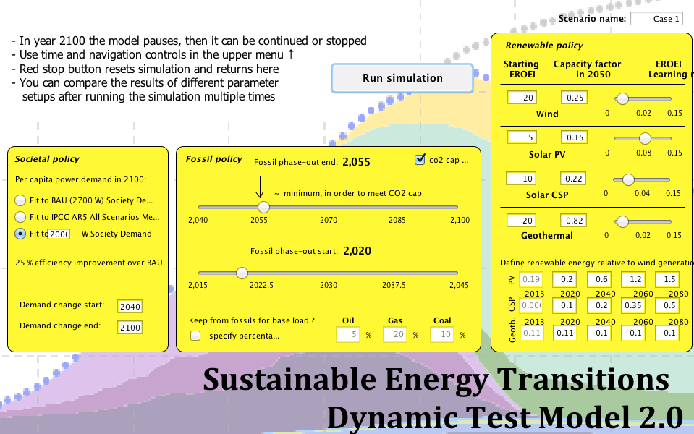
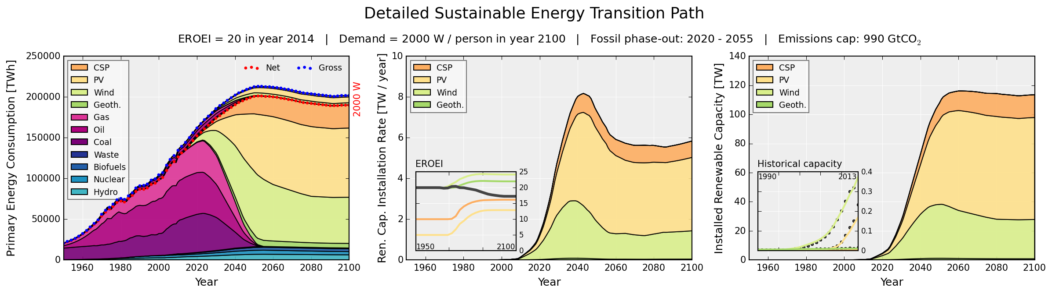
Potential Transition Pathways
Fossil fuel Peak in 2020 Phase-out by 2055
http://set.csaladen.es/set2.html
Sgouridis, Bardi, Csala (expected 2015)
GRAPH: Based on Sgouridis, Csala (2014) using data from EIA, BP, UNSD (model: http://www.runthemodel.com/models/2104/)
Notes:
Wealthy countries could afford to do that because of fossil fuels. 2 problems with that. Depletion and global warming.

Slide 16
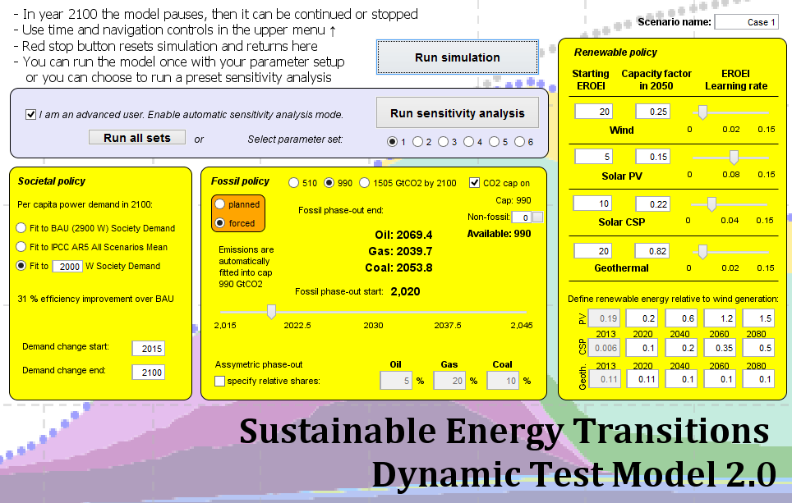
Sgouridis, Bardi, Csala (expected 2015)
GRAPH: Based on Sgouridis, Csala (2014) using data from EIA, BP, UNSD (model: http://www.runthemodel.com/models/2104/)
Notes:
Wealthy countries could afford to do that because of fossil fuels. 2 problems with that. Depletion and global warming.

Slide 17
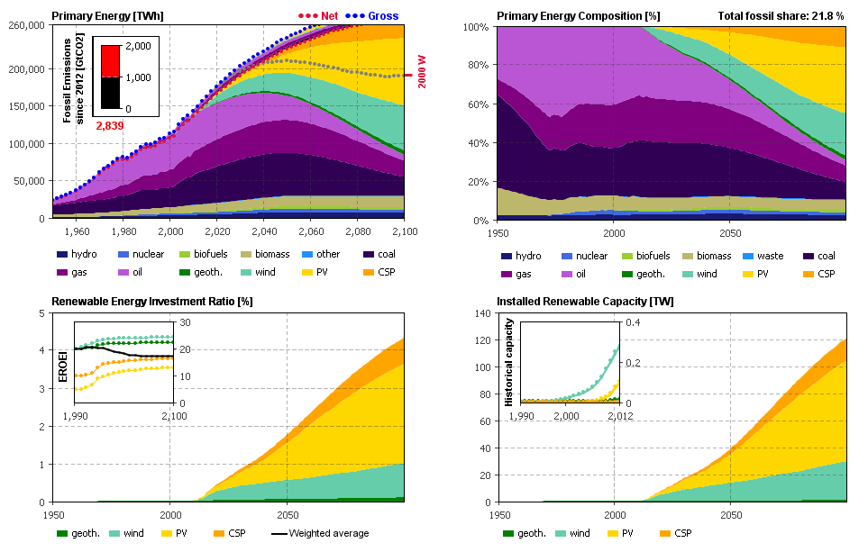
Sgouridis, Bardi, Csala (expected 2015)
GRAPH: Based on Sgouridis, Csala (2014) using data from EIA, BP, UNSD (model: http://www.runthemodel.com/models/2104/)
Notes:
Wealthy countries could afford to do that because of fossil fuels. 2 problems with that. Depletion and global warming.

Slide 18
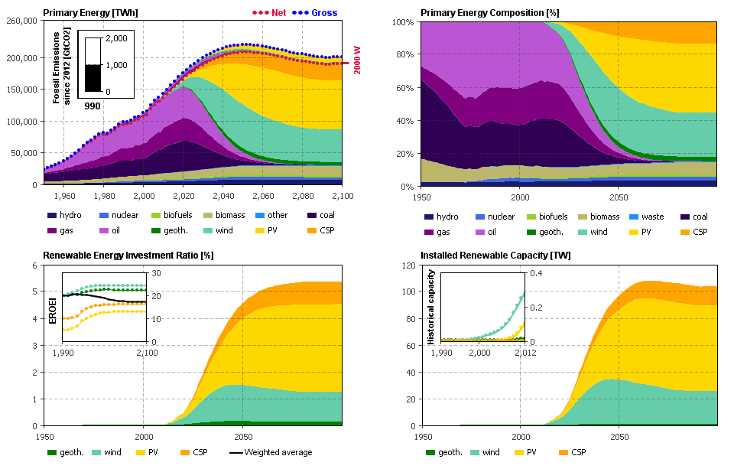
Sgouridis, Bardi, Csala (expected 2015)
GRAPH: Based on Sgouridis, Csala (2014) using data from EIA, BP, UNSD (model: http://www.runthemodel.com/models/2104/)
Notes:
Wealthy countries could afford to do that because of fossil fuels. 2 problems with that. Depletion and global warming.

Slide 19
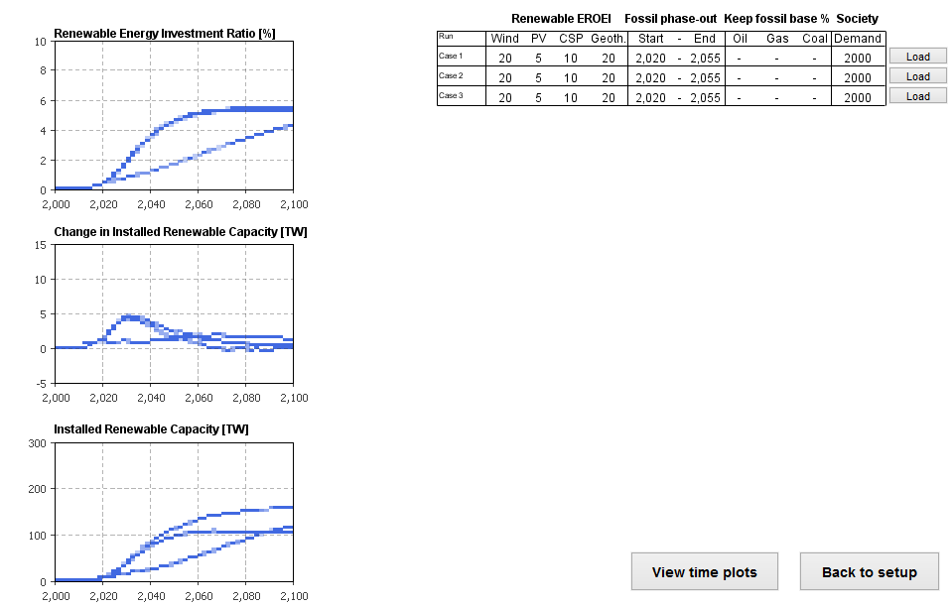
Sgouridis, Bardi, Csala (expected 2015)
GRAPH: Based on Sgouridis, Csala (2014) using data from EIA, BP, UNSD (model: http://www.runthemodel.com/models/2104/)
Notes:
Wealthy countries could afford to do that because of fossil fuels. 2 problems with that. Depletion and global warming.

Slide 20
Potential Transition Pathways
Fossil fuel Peak in 2020 Phase-out by 2055
SET EXAMPLE
Sgouridis, Bardi, Csala (expected 2015)
GRAPH: Based on Sgouridis, Csala (2014) using data from EIA, BP, UNSD (model: http://www.runthemodel.com/models/2104/)
Notes:
Wealthy countries could afford to do that because of fossil fuels. 2 problems with that. Depletion and global warming.

Slide 21
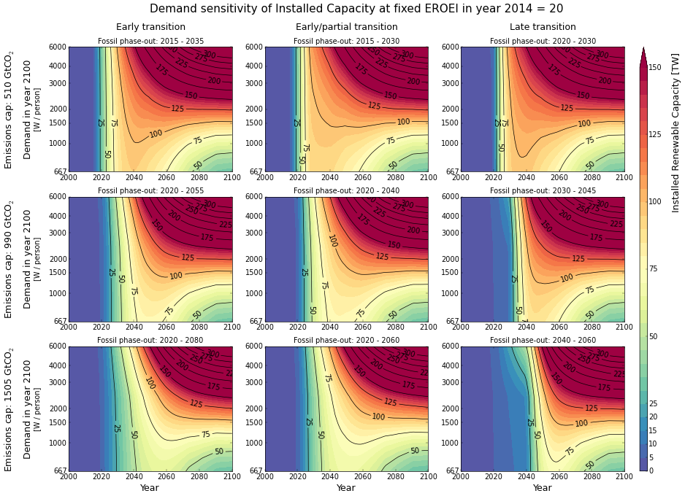
majority of additional capacity needs to be added before 2040
Initial acceleration phase similar irrespective of “efficient” economy
Transition speed and initial acceleration critical

Slide 22
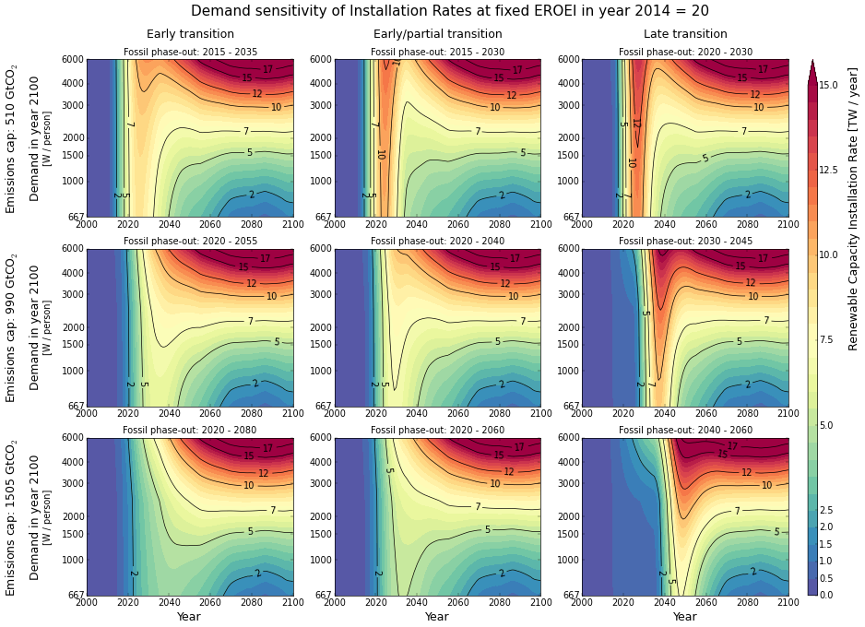
Transition peak varies significantly by cap and profile

Slide 23
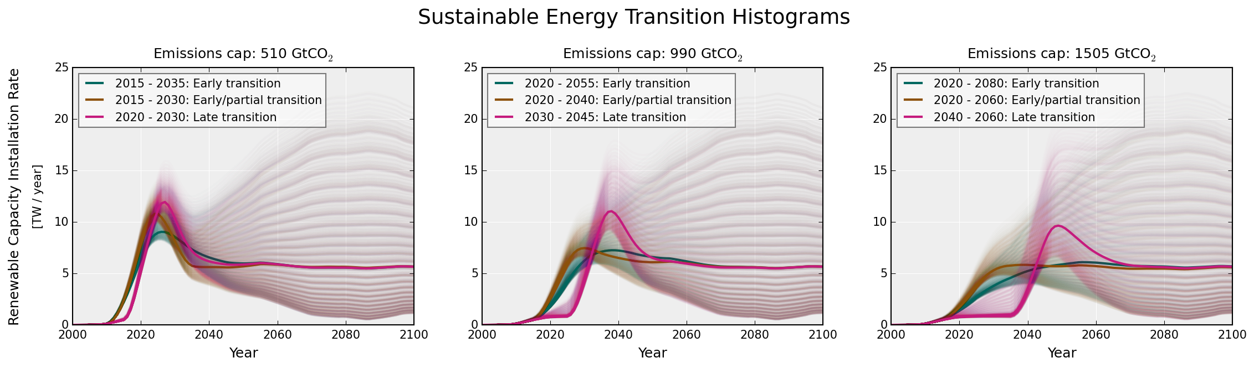
SET ENVELOPE
Late transition = much higher peak installation rates
Initial acceleration phase for early & fuel switch transition similar
For the 990Gt option they both peak at ~8GW/year (2030 vs 2040)
A ~40x increase from 2013 rate 0.18TW/year
Sgouridis, Bardi, Csala (expected 2015)
GRAPH: Own work based on the principles outlined by Sgouridis, Csala (2014) using open data from EIA, BP, UNSD
Notes:
Wealthy countries could afford to do that because of fossil fuels. 2 problems with that. Depletion and global warming.

Slide 24
Full paper: A Framework for Defining Sustainable Energy Transitions: Principles, Dynamics, and Implications
http://www.mdpi.com/2071-1050/6/5/2601 work in progress: http://set.csaladen.es
Other Selected References
Georgescu-Roegen, N. 1976. “Energy and Economic Myths: Institutional and Analytical Economic Essays” (January 1). http://www.osti.gov/scitech/biblio/7132086.
Daly, H. E. 1996. Beyond Growth: The Economics of Sustainable Development. Beacon Pr.
Hau, Jorge L, and Bhavik R Bakshi. 2004. “Promise and Problems of Emergy Analysis.” Ecological Modelling 178 (1–2) (October 15): 215–225. doi:10.1016/j.ecolmodel.2003.12.016.
Brown, M.T, and R.A Herendeen. 1996. “Embodied Energy Analysis and EMERGY Analysis: a Comparative View.” Ecological Economics 19 (3) (December): 219–235. doi:10.1016/S0921-8009(96)00046-8.
Hall, Charles A. S, and Kent A Klitgaard. 2011. Energy and the Wealth of Nations: Understanding the Biophysical Economy. Springer.
Hubbert, M. King. 1956. “Nuclear Energy and the Fossil Fuel.” Drilling and Production Practice.
Cavallo, Alfred J. 2004. “Hubbert’s Petroleum Production Model: An Evaluation and Implications for World Oil Production Forecasts.” Natural Resources Research 13 (4): 211–221.
Maggio, G., and G. Cacciola. 2009. “A Variant of the Hubbert Curve for World Oil Production Forecasts.” Energy Policy 37 (11) (November): 4761–4770. doi:10.1016/j.enpol.2009.06.053.
Heun, Matthew Kuperus, and Martin de Wit. 2012. “Energy Return on (energy) Invested (EROI), Oil Prices, and Energy Transitions.” Energy Policy 40 (January): 147–158. doi:10.1016/j.enpol.2011.09.008.
Murphy, David J., Charles AS Hall, Michael Dale, and Cutler Cleveland. 2011. “Order from Chaos: a Preliminary Protocol for Determining the EROI of Fuels.” Sustainability 3 (10): 1888–1907.
De Vries, Bert J.M., Detlef P. van Vuuren, and Monique M. Hoogwijk. 2007. “Renewable Energy Sources: Their Global Potential for the First-half of the 21st Century at a Global Level: An Integrated Approach.” Energy Policy 35 (4) (April): 2590–2610. doi:10.1016/j.enpol.2006.09.002.
Dale, Michael, and Sally M. Benson. 2013. “Energy Balance of the Global Photovoltaic (PV) Industry - Is the PV Industry a Net Electricity Producer?” Environmental Science & Technology 47 (7) (April 2): 3482–3489. doi:10.1021/es3038824.
Hartwick, John M. 1977. “Intergenerational Equity and the Investing of Rents from Exhaustible Resources.” The American Economic Review 67 (5): 972–974.
Marechal, François, Daniel Favrat, and Eberhard Jochem. 2005. “Energy in the Perspective of the Sustainable Development: The 2000 W Society Challenge.” Resources, Conservation and Recycling 44 (3) (June): 245–262. doi:10.1016/j.resconrec.2005.01.008.
Mohr, S. H., and G. M. Evans. 2009. “Forecasting Coal Production Until 2100.” Fuel 88 (11): 2059–2067.
———. 2011. “Long Term Forecasting of Natural Gas Production.” Energy Policy 39 (9): 5550–5560.
Beneš, Jaromír, and Michael Kumhof. 2012. “The Chicago Plan Revisited”. SSRN Scholarly Paper ID 2169748. Rochester, NY: Social Science Research Network. http://papers.ssrn.com/abstract=2169748.

Slide 25
Thank You

